Slide 1

Project Stage II Evaluation
Biopotential Controlled Drone
Amogh Bhosekar | 612309009
Nihar Joshi | 612309025
COEP Technological University, Shivajinagar, Pune

Slide 2
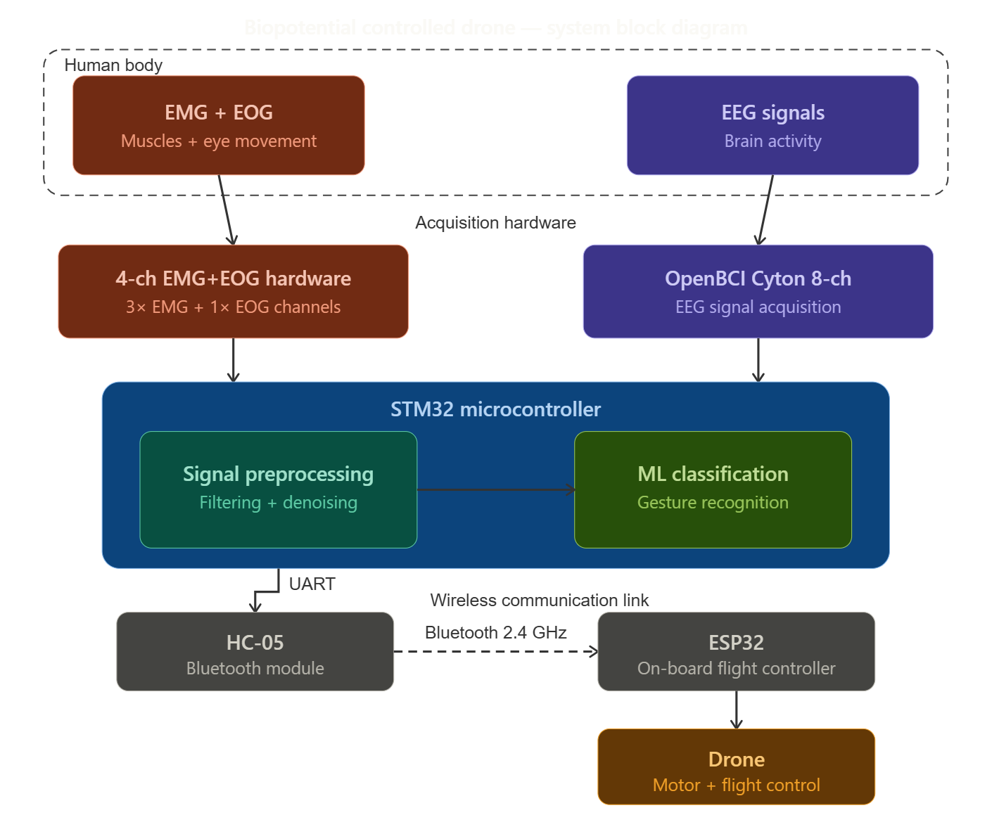
SYSTEM BLOCK DIAGRAM
COEP Technological University | Biopotential Controlled Drone

Slide 3
System Needs / Scope / Current Technology / Improvement
System Needs
Objectives
Current Technology
Improvement/Scope for Research
The existing EEG hardware is incapable of detecting relevant montages for Drone Control
To Harness EMG+EOG+EEG signals to control a drone
Hard Control- EMG+EOG
Stage 1: reliable signal acquisition and signal chain establishment
Stage 2: Harnessing this signal chain to control a drone
Focus on host machine implementation of algorithms
Binary EEG Control/ON-OFF Control
No comprehensive quick system calibration
Continuous Control using intensities of ERD/ERS
Lack of low cost marketable product in this domain
COEP Technological University | Biopotential Controlled Drone

Slide 4
Biopotential Signal Acquisition – EMG
Current Architecture
Methodology
BioAmp EXG Pill+ ESP32
ML algorithm run on host machine on MATLAB
Simple Linear Regression
Accuracy ~70%
Acquisition: Simultaneous capture of EMG/EOG (custom hardware) and EEG (OpenBCI Cyton) signals.
Central Processing: Real-time data stream integration via STM32 microcontroller.
Signal Conditioning: On-board digital filtering and denoising to isolate control features.
Classification: Edge AI execution for gesture recognition and intent decoding.
Communication: Wireless command transmission via HC-05 Bluetooth (2.4 GHz).
Execution: Command translation by ESP32 for motor modulation and flight control.
System Improvement Results
Using a neural network for a 3-class classification
Improved accuracy ~90%
COEP Technological University | Biopotential Controlled Drone

Slide 5
Integrating MCU — STM32 Selection
STM32 SELECTION
Current technologies use host machine like a laptop or a CPU for ML computations, which doesn’t make the device portable
STM32 has an on board FPU which has the capability to run algorithms on its own
STM32 offers better industry standard 12 bit ADC with much lesser noise
Better on board digital filtering capabilities
Lastly STM32 can be programmed to be in Ultra Low Power mode thus enhancing battery more efficiently than its ESP32 counterparts
COEP Technological University | Biopotential Controlled Drone

Slide 6
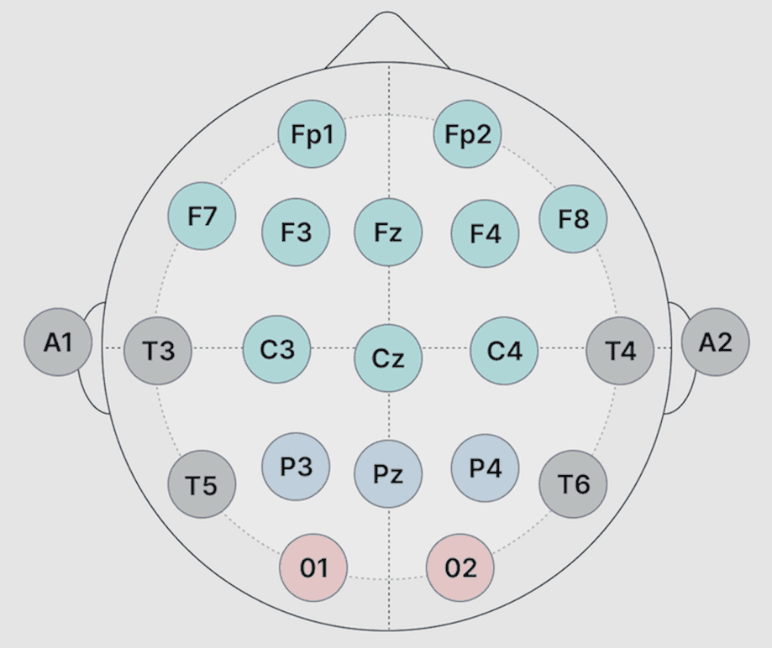
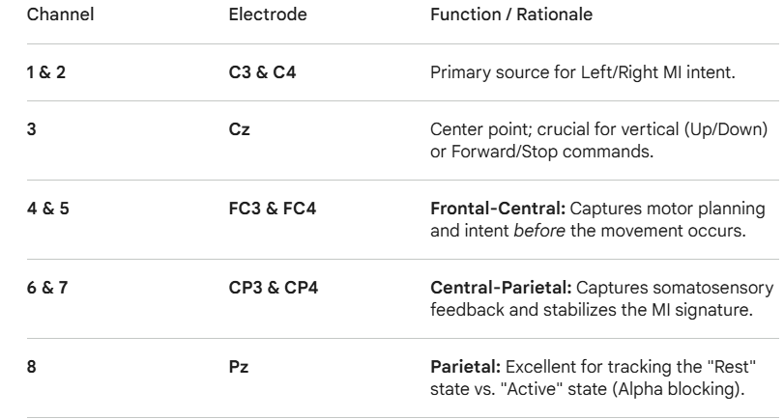
Biopotential Signal Acquisition – EEG
EEG Signal Acquisition
Literature Survey
Here are the links to few of the research papers:
A Cooperative EEG-based BCI Control System for Robot–Drone Interaction
A High-DOF BCI Control Strategy Mapping Discrete Commands to Continuous Motion for a Drone
Decoding of Multiple Wrist and Hand Movements Using a Transient EMG Classifier
Overview of EEG, Electrode Placement, and Montages
Cyton Specs
COEP Technological University | Biopotential Controlled Drone

Slide 7
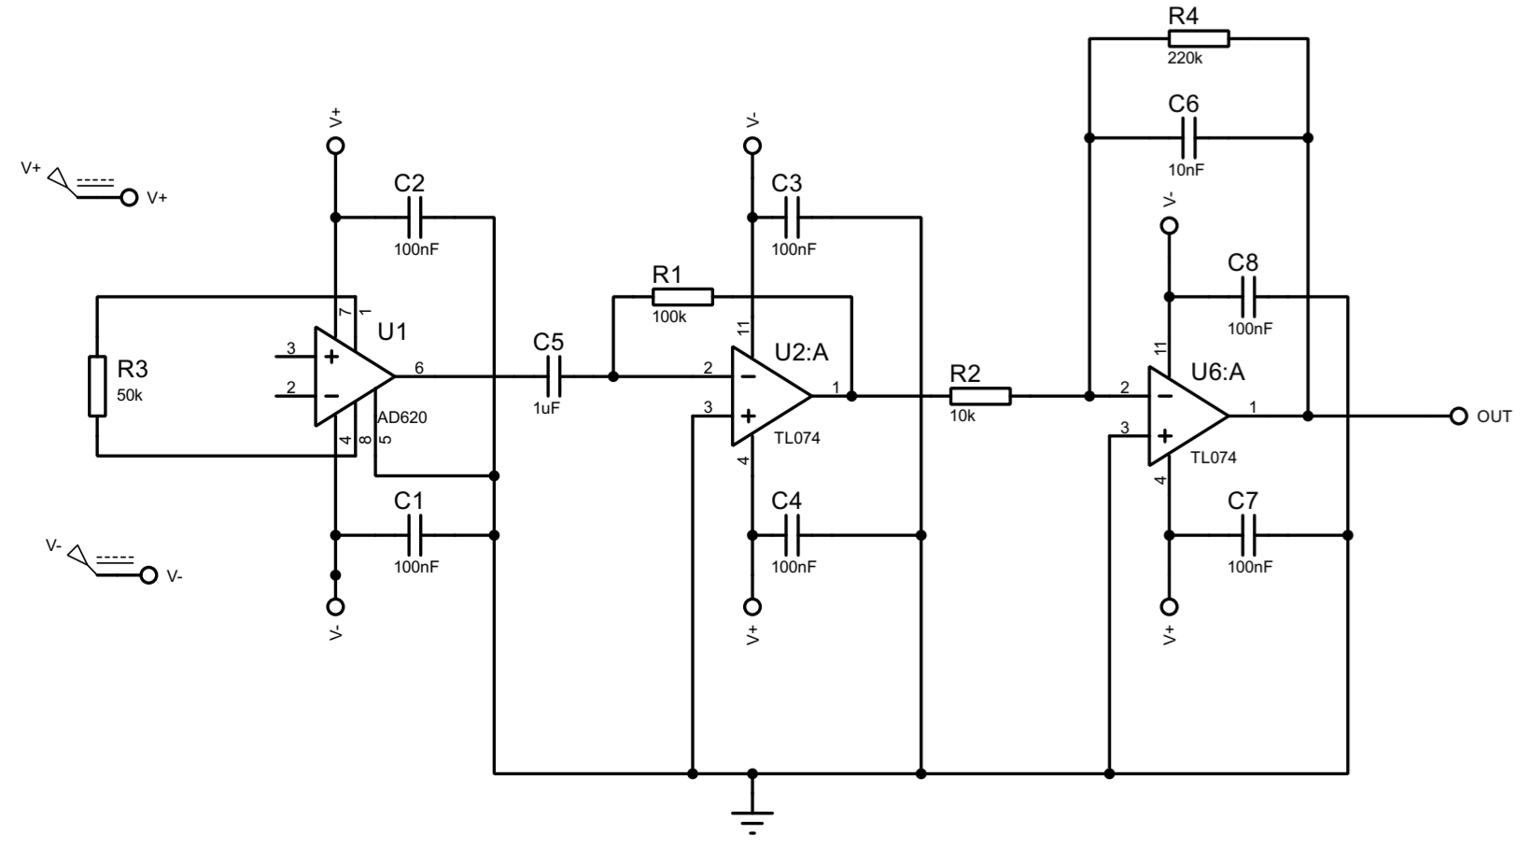
EMG AFE Circuit Design
Single channel circuit diagram
Need
[ Circuit Schematic]
Custom 4 channel data acquisition system
Low noise, low power (specs further ahead)
Useful for classification of wrist/arm movement detection for the UAV control application
COEP Technological University | Biopotential Controlled Drone

Slide 8
Specifications of EMG AFE circuit
AD620 instrumentation amplifier: amplify small differential EMG signals and reject noise
CMRR: 100-120dB
High input impedance (order of gigaohms)
HPF with 1.6Hz cutoff frequency to suppress low frequency drift
LPF with 72Hz cutoff frequency to suppress high frequency noise
TL074 quad JFET amplifier used for active gain stage and filtering
Bandpass: 1.6Hz to 72Hz
Differential supply operation for headroom
100nF decoupling capacitors at each amplifier stage
Single ended output for ADC of receiving microcontroller such as STM32
COEP Technological University | Biopotential Controlled Drone

Slide 9
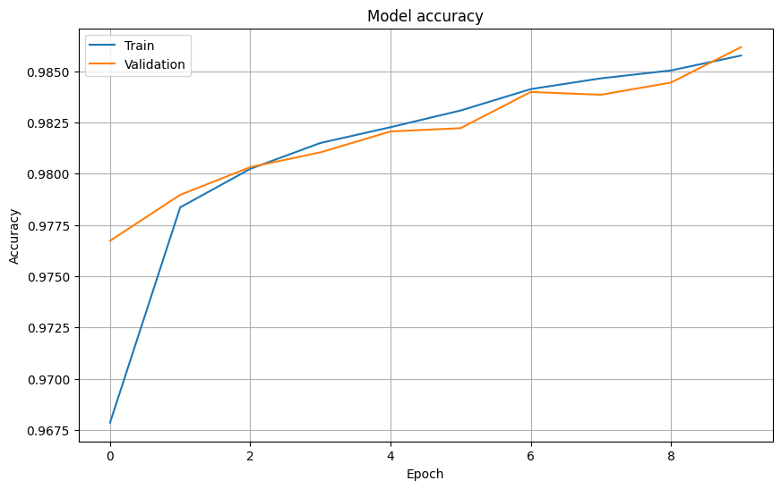
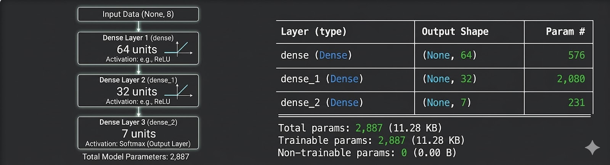
Existing EMG Hardware & Neural Network Results
Neural Network — Trained Accuracy & Results
Neural Network — Architecture
Importing these pretrained weights helps reduce the model training time
COEP Technological University | Biopotential Controlled Drone

Slide 10
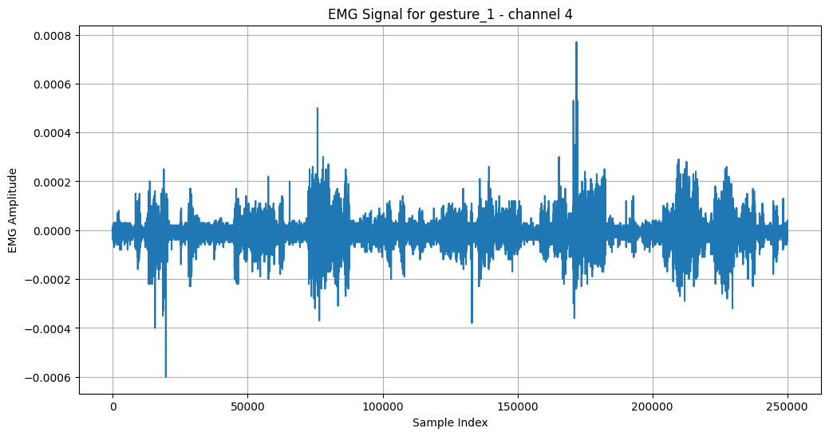
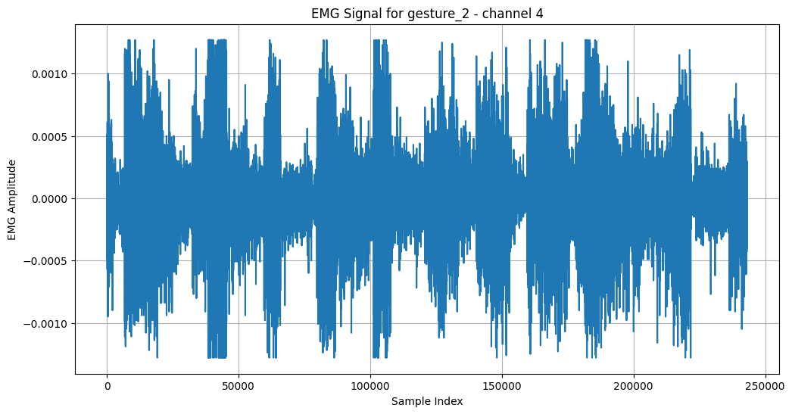
Existing EMG Hardware & Neural Network Results
Rest State
Wrist Clench
The network identifies these states by mapping raw signal intensity and burst frequency to specific mathematical signatures. For Rest, it recognizes low-amplitude baseline noise; for Wrist Flexion, it detects sustained, high-power waveforms; and for Wrist Clench, it isolates rapid, high-intensity spikes. These features are processed through hidden layers to create abstract "shapes" for each gesture, with the final Softmax layer assigning a probability to each class to select the most likely control command.
COEP Technological University | Biopotential Controlled Drone

Slide 11
Future Work
01
03
EEG signal acquisition post arrival of hardware and designing an appropriate Electrode hardware based on the relevant EEG montages
Working on implementing the Wrist detection ML model on STM32 via the STM32Cube.AI and developing new models for the acquired EEG signals
02
04
Coding the Drone for stability and then integrating the acquired biopotential signals into the existing drone control logic
Testing and Implementing the custom 4 channel EMG+EOG setup and integrating it with the existing signal chain
COEP Technological University | Biopotential Controlled Drone

Slide 12
Applications Analysis
Medical Rehabilitation
Military & Surveillance
Search & Rescue
Patient Bedside Pill Delivery
Enabling pilots to control auxiliary drones simultaneously using EOG/EEG triggers.
Operating drones in toxic or confined environments using hands-free biological signals for safer exploration.
Entertainment & Gaming
Accessibility Solutions
Research & Development
Creating immersive, hands-free experiences where drone flight is modulated by the user's focus and emotional state rather than physical input.
Providing quadriplegic individuals with independent "eyes-in-the-sky" for personal navigation and environmental monitoring.
Prototyping real-time Edge AI architectures on STM32 to bridge the gap between lab-grade BCI and field deployment.
COEP Technological University | Biopotential Controlled Drone

Slide 13
Thank You
Amogh Bhosekar (612309009) · Nihar Joshi (612309025)
COEP Technological University, Shivajinagar, Pune
Mid Semester Project Stage II Evaluation

